Slide 1

Computer Networking (IT-3001)
KALINGA INSTITUTE OF INDUSTRIAL TECHNOLOGY
Deemed to be University, Bhubaneswar
4 Credit
Autumn-2018

Slide 2
Web Caching
Caching is storing something temporarily for fast retrieval later on.
Web Caching is storing of HTTP responses temporarily for fast retrieval later on.
Systems using web caching : Systems have their different purpose of web caching.
- Search Engines
- Web Browsers,
- Web Proxies (Web Servers)are some systems which widely cache web files.

Slide 3
Advantages of Web Caching
To reduce latency – Because the request is satisfied from the cache (which is closer to the client) instead of the origin server, it takes less time for the client to get the object and display it. This makes Web sites seem more responsive.
To reduce traffic –Web caching reduces the number of requests made to the server. Due to which less bandwidth is consumed by clients and web server load is reduced. This saves money if the client is paying for traffic, and keeps their bandwidth requirements lower and more manageable.

Slide 4
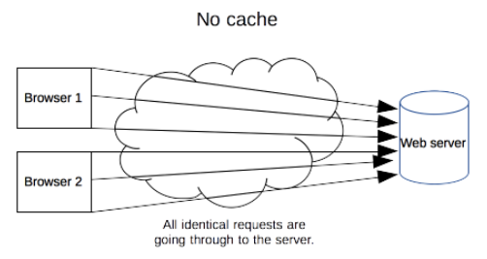
Types of Web Caches
No Cache

Slide 5
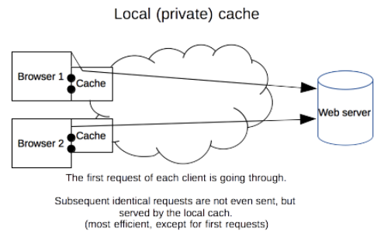
Types of Web Caches...
Private Cache or Web Browser Cache
A private cache is dedicated to a single user.
This cache is used to make visited documents available for back/forward navigation, saving, viewing-as-source, etc. without requiring an additional trip to the server.

Slide 6
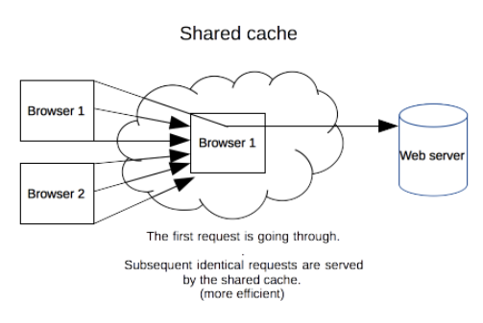
Types of Web Caches...
Shared Cache or Proxy Server Cache
A shared cache is a cache that stores responses to be reused by more than one user.
An ISP or company might have set up a web proxy as part of its local network infrastructure to serve many users.

Slide 7
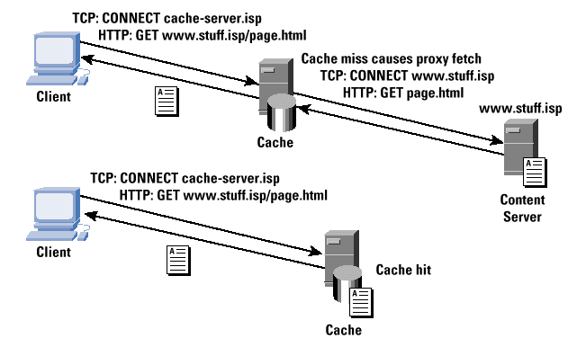
Types of Web Caches...

Slide 8
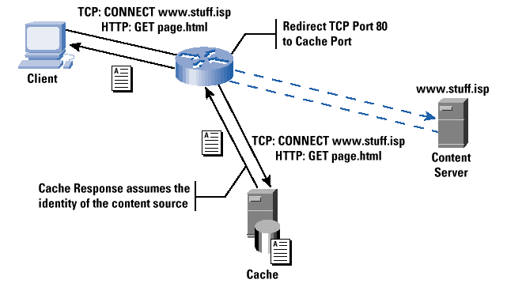
Types of Web Caches...

Slide 9
How to Control Caches (HTTP Cache Control Mechanism)
The caching mechanism can be controlled using
- Caching meta tags or
- HTTP caching headers
Meta tags : Here HTML authors can put tags in a document’s <HEAD> section that describe its attributes. Meta tags are easy to use, but aren’t very effective. That’s because they’re only honored by a few browser caches, not proxy caches.
HTTP Headers give the a lot of control over how both browser caches and proxies handle the responses for caches. Different Types of Headers are
Expires, Cache-Control, Eta, Last-Modified, Content-Length, Vary

Slide 10
How to Control Caches (HTTP Cache Control Mechanism)...
Typical HTTP 1.1 response headers might look like this:
HTTP/1.1 200 OK
Date: Fri, 30 Oct 1998 13:19:41 GMT
Server: Apache/1.3.3 (Unix)
Cache-Control: max-age=3600, must-revalidate
Expires: Fri, 30 Oct 1998 14:19:41 GMT
Last-Modified: Mon, 29 Jun 1998 02:28:12 GMT
ETag: "3e86-410-3596fbbc"
Content-Length: 1040
Content-Type: text/html

Slide 11
The HTTP Cache Control Header
The Cache-Control HTTP/1.1 header is used to specify directives for caching mechanisms.
A number of different policy instructions can be set using this header, with multiple instructions being separated by commas. Use this header to define your caching policies with the variety of directives it provides.
Cache-Control (HTTP/1.1) Directives
no-store - never cache this message
no-cache - may cache but need revalidation
public - public may cache
private - intended for single user
max-age - set expiration
must-revalidate - require revalidation
Cache-Control (HTTP/1.0) Mechnism
Expires: Thu, 01 Jan 1970 00:00:00 GMT
Pragma: no-cache

Slide 12
The HTTP Cache Control Header Examples
Cache-Control : max-age=86400 Cache-Control : max-age=60 | Response can be cached by browser and any intermediary caches (that is, it's "public") for up to 1 day (60 seconds x 60 minutes x 24 hours).This indicates that the response can be cached and reused for the next 60 seconds.
Cache-Control : private, max-age=600 | Response can be cached by the client’s browser only for up to 10 minutes (60 seconds x 10 minutes).
Cache-Control : no-store | Response is not allowed to be cached and must be fetched in full on every request.
Expires: -1Cache-Control: no-store | Here these systems will not cache the response.

Slide 13
The HTTP Cache Control Header Examples
Expires: Thu, 15 Aug 2060 09:00:00 GMT Cache-Control: no-cache, must-revalidate, expires=360000000 | Here these systems will cache the response but before serving the response the client will try to revalidate but as we didn’t provide Last-Modified header, client will send revalidation request without If-Modified-Since and therefore server will response with 200 status code which is refetching the page again.
Expires: Thu, 15 Aug 2015 09:00:00 GMT Last-Modified: Thu, 15 Aug 2011 09:00:00 GMT | Here browser will cache the document till 15 Aug 2015 09:00:00. Client will not revalidate the cache before serving.
If-Modified-Since: Mon, 15 August 2003 00:00:00 GMT | Now the server sees the If-Modified-Since header and checks if it was modified since then or not.

Slide 14
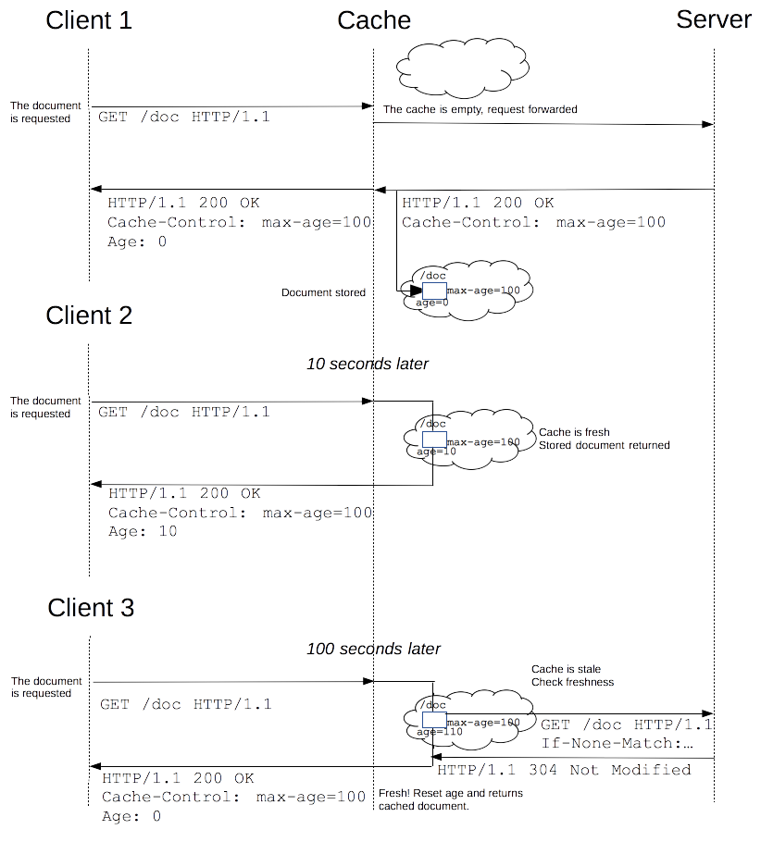
The HTTP Cache Control Header

Slide 15
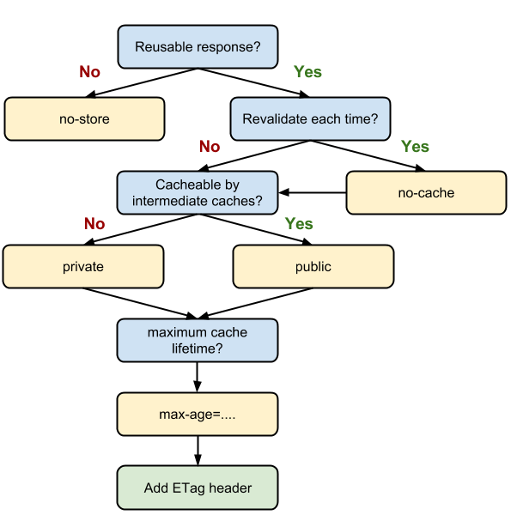
Optimal Cache-Control policy

